Slide 1
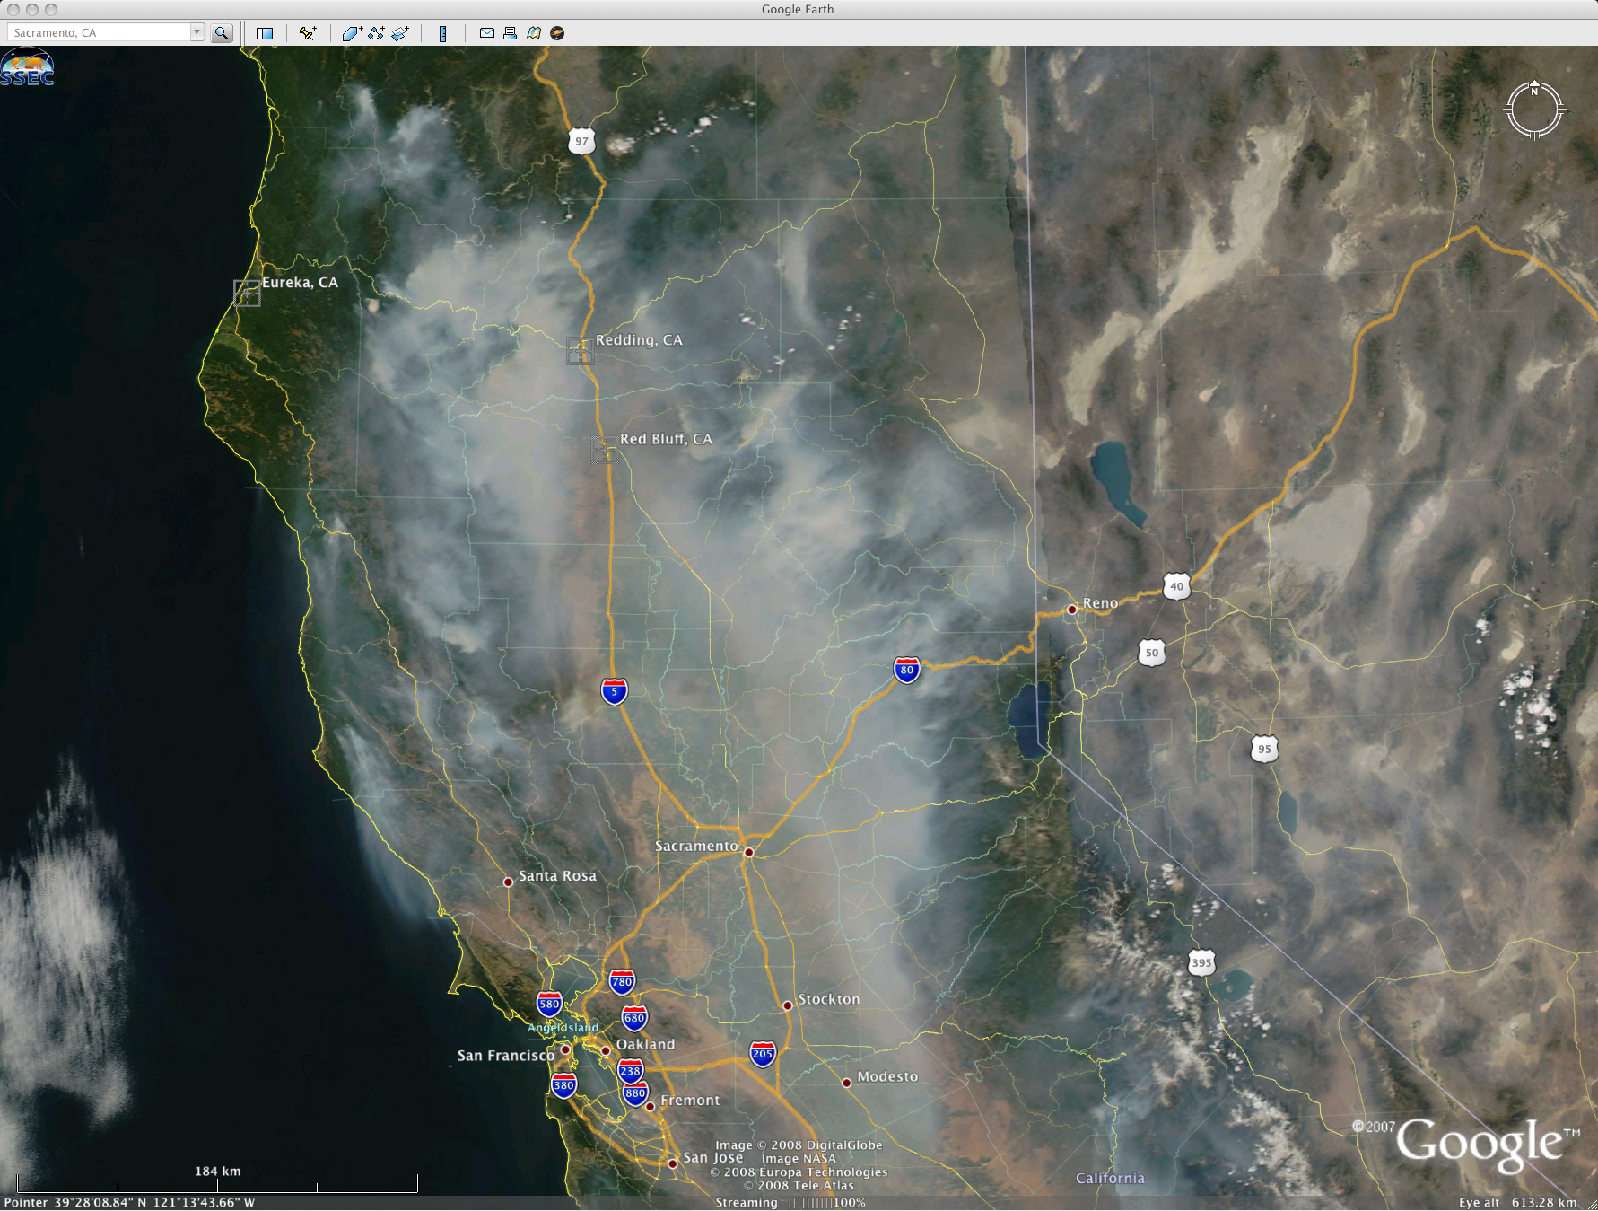

Adjoint sensitivity in an online weather forecast model: Developing the Adjoint of Black Carbon in WRFPLUS
August 20, 2013
Jonathan Guerrette (CU Boulder)
Daven Henze (CU Boulder)
Gregory Carmichael (University of Iowa)
EPA-G2010-STAR-L1
Image: MODIS true color image on June 24, 2008 (http://cimss.ssec.wisc.edu/)

Slide 2
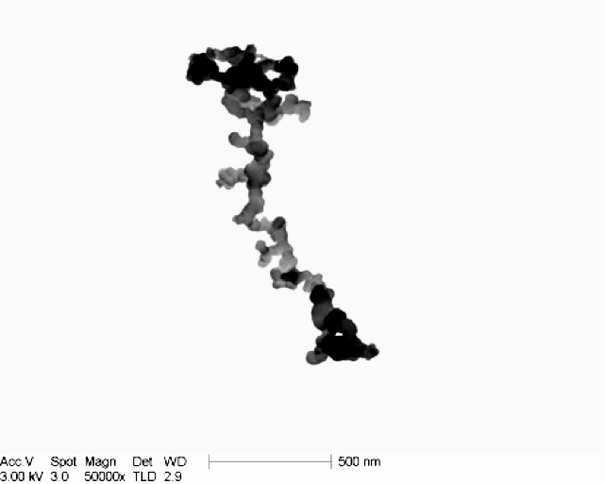
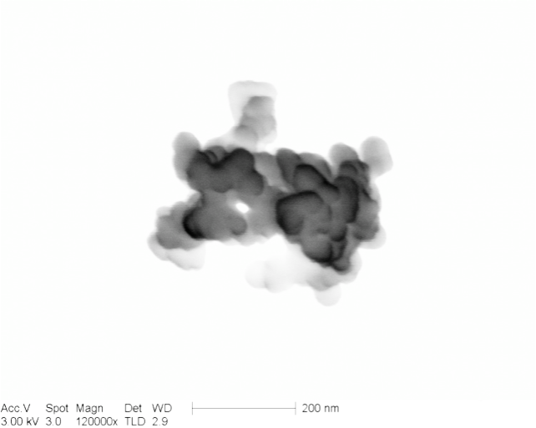
Black Carbon
Hydrophobic
Hydrophilic
D ≈ 200-800nm (Encompasses wavelength of visible light)
http://cires.colorado.edu/jimenez-group/wiki/index.php/DAURE_Microscopy
Esther Coz of CIEMAT/IDAEA-CSIC at RJ Lee Group, Inc. facilities
Notes:
This is Black Carbon.
Freshly emitted Hydrophobic black carbon has a long chain structure while aged Hydrophilic BC has been oxidized by sulfuric and organic acids, readily takes up condensed water, and takes on a more spherical shape.
The characteristic length of both encompass the wavelength of visible light, making it optically active in the atmosphere.

Slide 3
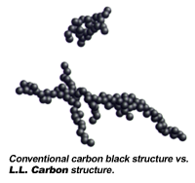
Black Carbon
Incident Radiation
Black Carbon
Particle
Air Molecule
INCIDENT – TRANSMITTED = ABSORBED + SCATTERED
Transmitted Radiation
Notes:
Black Carbon is a radiation absorber.
Increasing the concentration of BC in an air mass increases the energy absorbed in that volume per unit time, and reduces the energy transmitted through.
The absorbed radiation is converted to kinetic energy, and thus a local increase in temperature relative to a clean air mass.

Slide 4
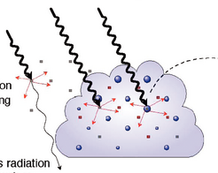
Radiative Forcing Phenomena
Direct radiative forcing
Local temp. change
Semi-direct effect
Increased static stability below BC (warming or cooling)
Cloud evaporation
[Source: IPCC AR4, Chapter 7. 2007]
Notes:
Black Carbon is a radiation absorber.
[Point to left of first figure] This absorption is described as direct radiative forcing because it directly impacts temperature in a specific location.
In contrast, the semi-direct effect is a result of direct forcing. Warming above or below the cloud base decreases or increases stability by changing the temperature gradient. Additionally, BC in clouds increases temperature, which causes evaporation and lower cloud albedo. Reduction in clouds increases surface temperature.

Slide 5
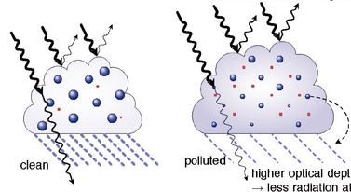
Radiative Forcing Phenomena
Aerosol Indirect Effect
Increase in cloud albedo and lifetime due to increased cloud condensation nuclei
[Source: IPCC AR4, Chapter 7. 2007]
Notes:
The indirect affect is caused by all aerosol impurities in the air. A polluted air mass has more surfaces for water vapor condensation. This makes cloud formation more favorable, and also increases cloud lifetime because there is less water available for any one cloud droplet to grow to a rain drop.
One of the big discussions in research right now is if polluted air masses intensify Deep Convective rain events by delaying the rain until a higher critical mass, but this of course competes with the stabilizing/destabilizing semi-direct effect.

Slide 6
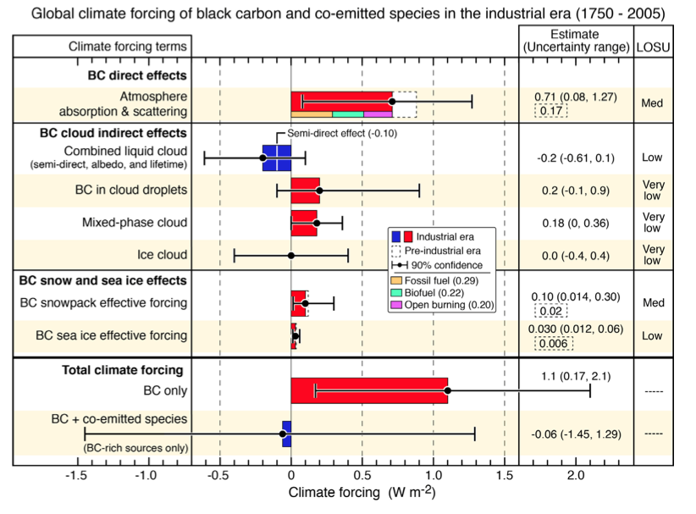
Anthropogenic BC Climate Forcing
CO₂
Bond et al. (2013)
Notes:
The first two boxes show the estimated forcing due to each of these mechanisms
BC on snow/ice is also shown.
These are generally positive, which gives the positive total, but the forcing from the semi-direct and albedo effects is negative and large error bars are common across the board.
Compare the total forcing of BC to CO2, and you can see why it’s important. Then compare their error bars and the goal of my research becomes apparent. We need to understand this mechanism better in order to make any policy decisions. If we can do something about BC with policy, the effects would be felt within a week of changes in human activity, whereas CO2 has a lifetime of 100 years or more.

Slide 7
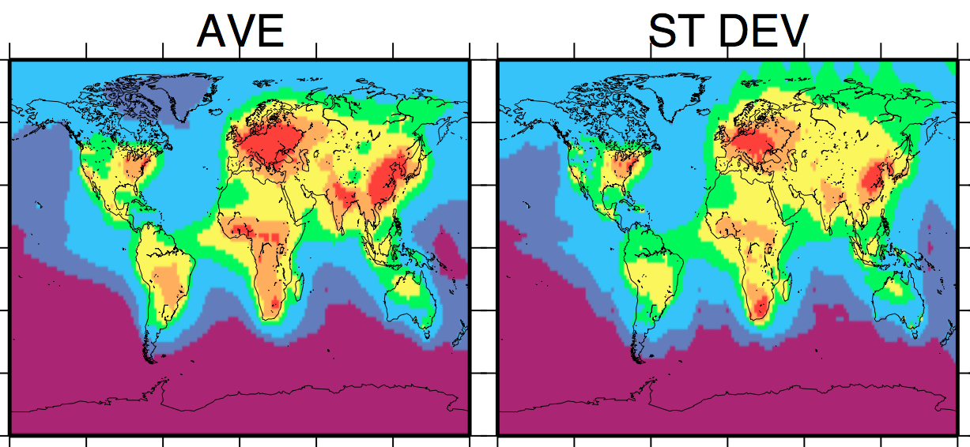
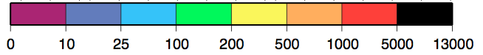
Global BC Surface Concentration (model year 2000)
Koch et al. (2009)
Notes:
The largest source of uncertainty in global radiative forcing estimates are unknowns in the spatial and temporal distribution of BC. These are the annual average and standard deviation of 17 models from the AeroCom Intercomparison project. The average and error are on the same scale, indicating the distribution is not well-understood. The picture is worse for seasonal and monthly concentration predictions.
This is disconcerting but also gives a route to improving radiative estimates.…What are the sources of uncertainty in concentration??? –next slide

Slide 8
Concentration Uncertainty Attribution
Boundary Conditions: upstream chemical boundary should be well-characterized or based on global model results
Emissions Inventories
Anthropogenic (e.g. diesel, industrial coal, biofuel cooking/heating) [1,220 to 15,000 Gg yr⁻¹]
Open Biomass Burning [2,000 to 11,000 Gg yr⁻¹]
Vertical Mixing/Transport (future work)
Wet/dry Deposition Losses (future work)
Notes:
Being the source of BC and plagued by high uncertainty, emissions are the largest source of error.
The global emissions for ANTHRO and BIOMASS emissions vary by an order of magnitude. the mean estimates are 4770 and 2760 each, with 8% and 45% accounted for by pre-industrial emissions. This 92% of ANTHRO and 55% of BB are linked to human activities. The errors are worse on regional and local scales.
The vertical distribution of Black Carbon is important to determining the effective forcing of the semi-direct effect. PBL and Convective mixing are the primary mechanisms here, and additionally plume rise for hot fires.
Losses need to be accounted for appropriately so that BC does not build up in the model.
For now, I will analyze BC sources since they are not well constrained by physics, and show the most promise for immediate improvement.

Slide 9
How to determine error sources?
Sensitivity Studies
Perturb model inputs
Non-exact derivatives, low detail information
Expensive for thorough study of all inputs
N+1 model runs for N finite difference sensitivities (see below)
Adjoint
Exact sensitivities
Single model run for sensitivity of single output to all inputs
u, v, w, T, q_{v}, [BC] and E_{BC} at all input locations/times
Example model run: 192,000 locations, 24 hourly times.
Data Assimilation: Assess error sources and reduce model bias by perturbing inputs (future work)
Notes:
Non-exact – the accuracy of finite difference derivatives is dependent on the perturbation size
Non-specific – often turn all emissions on/off or double/triple all ANTHRO, or all BB
Expensive – many model runs to see entire envelope of sensitivities

Slide 10
Offline vs. Online Meteorology
Chemical Transport Model (CTM)
Offline physics state variables from reanalysis data
dt = 1-6 hr, with interpolation
Direct radiative forcing only
MET-Chem model
Online dynamics solved every time step
Feedbacks between BC absorption and meteorology
Direct and cloud radiative forcing
Notes:
Another modeling choice is whether to use offline or online meteorology.
Offline MET is sufficient for direct radiative forcing studies, the first box in climate forcing figure.
Assimilated Reanalysis data for winds, temperature, and moisture are read in every 1-6 hrs.
Online MET solves nonlinear dynamic equations and advection of BC every time step, on the order of minutes, depending on grid spacing.
Such a model is also capable of calculating the feedbacks between BC absorption, and meteorology.
In other words, the semi-direct and indirect effects.
An chemistry adjoint with online meteorology has not yet been developed.

Slide 11
Previous CTM Adjoint Studies
“Adjoint inverse modeling of BC during the Asian Pacific Regional Aerosol Characterization Experiment”
Hakami et al. (2005)
Recovered spatially resolved anthropogenic and biomass-burning emissions using 4DVar Data Assimilation
“Origin and radiative forcing of black carbon transported to the Himalayas and Tibetan Plateau”
Kopacz et al. (2010)
Notes:
An chemistry adjoint with online meteorology has not yet been developed.
There are CTM adjoints though. A literature search will yield several papers using the GEOS-Chem adjoint.
Hakami et al. recovered spatially resolved BC emissions over the Asian Pacific using 4DVar, which requires the adjoint.
Kopacz et al. determined sources of BC in the Himalayas and Tibetan Plateau, and their impact on direct radiative forcing there.

Slide 12
WRF Model Capabilities
WRF Meteorology:
Non-hydrostatic moist dynamics, diffusion, subgrid parameterizations for PBL, Cumulus Convection, Microphysics, Radiation
WRF-Chemistry: Advection, emission, fire plume rise, 1st-order decay, dry/wet deposition losses, PBL and convective transport of Black Carbon and other chemical compounds
WRFPLUS: Adjoint and Tangent Linear models for dynamics, diffusion, and select parameterizations
WRFDA:
3DVAR and 4DVAR data assimilation predicated on WRFPLUS
Notes:
WRF solves non-hydrostatic, moist dynamic equations, plus diffusion, and subgrid parameterizations for BL, CUMULUS, MP, RAD
WRF-Chem adds to that emissions, advection, losses, and vertical transport of Black Carbon and other chemical compounds.
Prior to this work, WRFPLUS contained the adjoint and tangent linear for standard WRF physics routines. My recent efforts have been directed at adding chemistry to those models.
In the future, we will use WRFPLUS-Chemistry with WRFDA to do chemical data assimilation.

Slide 13
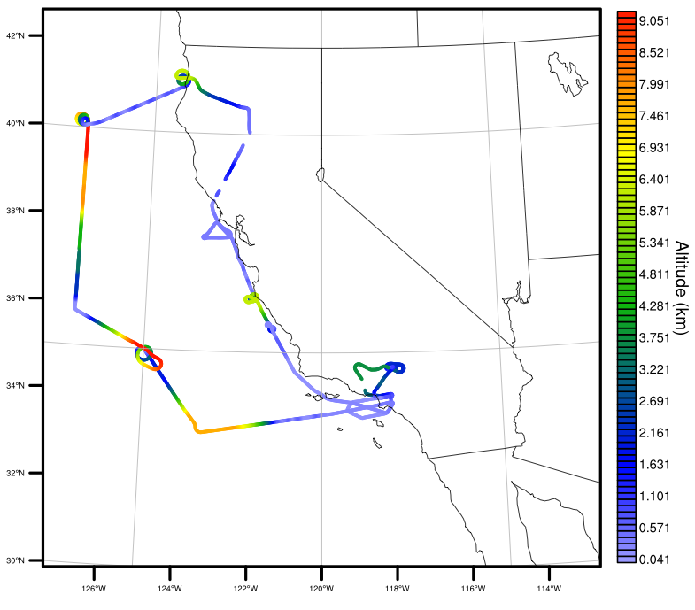
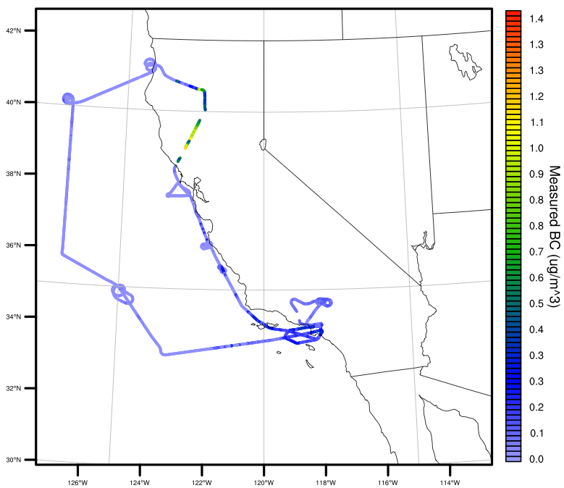
2008 ARCTAS-CARB Case Study
9
Aircraft retrievals Jun 20, 22, 24, 26 over CA
BC measured from SP2 device on board DC-8
Fires in Northern California
Clear skies (no cumulus clouds)
Altitude (km)
DC-8 flight path, June 22
1.4
0
Measured BC (ug/m³)
0
Notes:
In order to show current WRF performance and the adjoint developments, I will focus on a case study during the 2008 ARCTAS-CARB campaign.
The campaign took aircraft measurements over the Arctic and California over a period of 2 months in the spring and summer of 2008.
Observations over California were taken for 4 of those days. For these 4 days, there were fires burning in Northern California, and the weather was characterized by very little moisture or rainfall.
One of those 4 days included a DC-8 flight through the smoke plumes of several of the fires. The flight was aimed at characterizing morning and afternoon commute chemical concentrations over LA, influx concentrations from Asia across the Pacific both near and 300 km off the coast. The flight altitude ranged between the surface and perhaps 2/3 of TO-troposphere. The measured BC shows elevated values around LA, low Pacific boundary values, and very high concentrations over the fires.

Slide 14
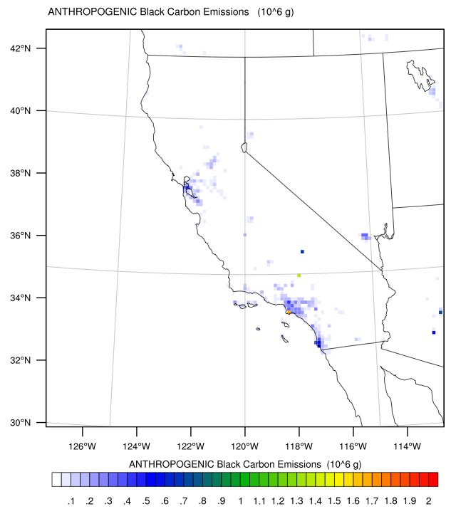
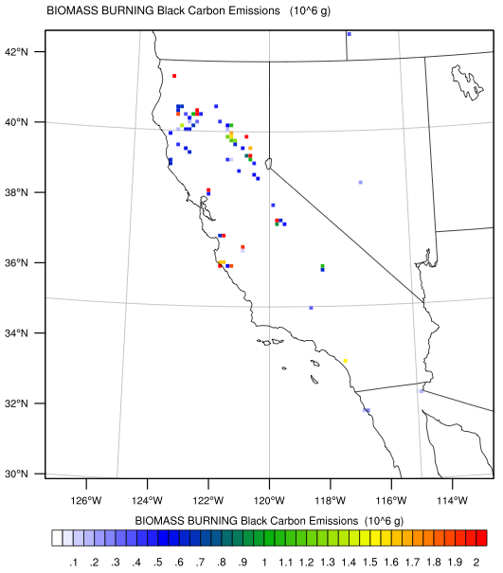
Jun 22, 2008 Emissions
NEI2005 Anthropogenic Emissions
FINN Biomass Burning Emissions
Crescent City
Chico
Reno
Monterey
Bakersfield
Notes:
The anthropogenic emissions are primarily concentrated around the three major CA cities: SF, SD, LA.
The burning emissions stretch from Crescent City in the north to Monterey in the South on the coast, and West of Bakersfield inland.

Slide 15
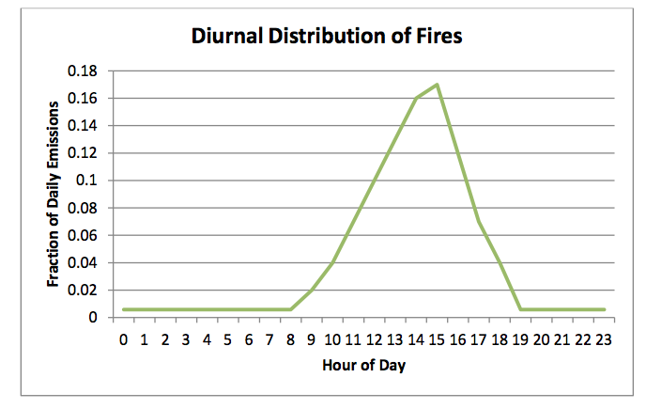
BC Biomass Emissions Diurnal Cycle
(Local Standard Time)
Notes:
The total daily magnitude of the burning emissions are distributed throughout the day according to this daily cycle for all emissions locations.
This is because the FINN emissions are derived from 2 daily satellite passes that determine WHERE a fire is occurring, its SIZE, and how HOT it is burning. Some diurnal variation is needed in order to distribute the emissions realistically throughout the day.
Still each fire behaves uniquely and will spread or diminish quickly, depending on local moisture, wind, and vegetation types. Just as these factors control fire spread, they also affect the amount of emissions per burned area to to combustion completeness. All of these different factors are candidates for improvement in BB inventories.

Slide 16
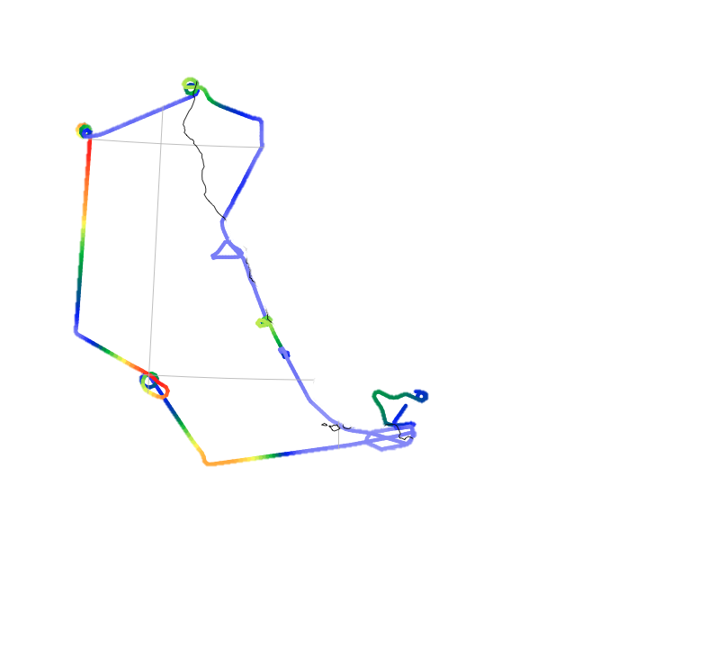
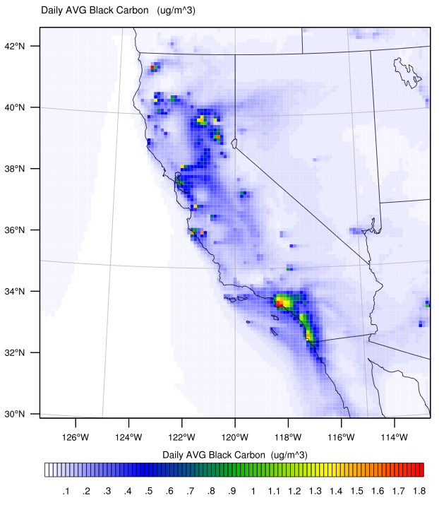
WRF-Chem Model Setup
dx = 12 km
(120 x 120 x 30 levels)
dt = 60 seconds
Initial Conditions:
Spin-up from Jun 15
Boundary:
[BC] = 0.01ug/m³
Anthropogenic: NEI2005
Biomass Burning: FINN
Jun 22 Average WRF-Chem Surface BC
(ug / m³)
Notes:
I’ve used WRF-Chem to try to reproduce the observation values. I am using a 12 km grid with 30 levels, and a 1 minute time step.
I’ve spun up from Jun 15 to typical concentrations. The up-stream boundary condition is 0.01 ug/m³, which is typical for transport from Asia.

Slide 17
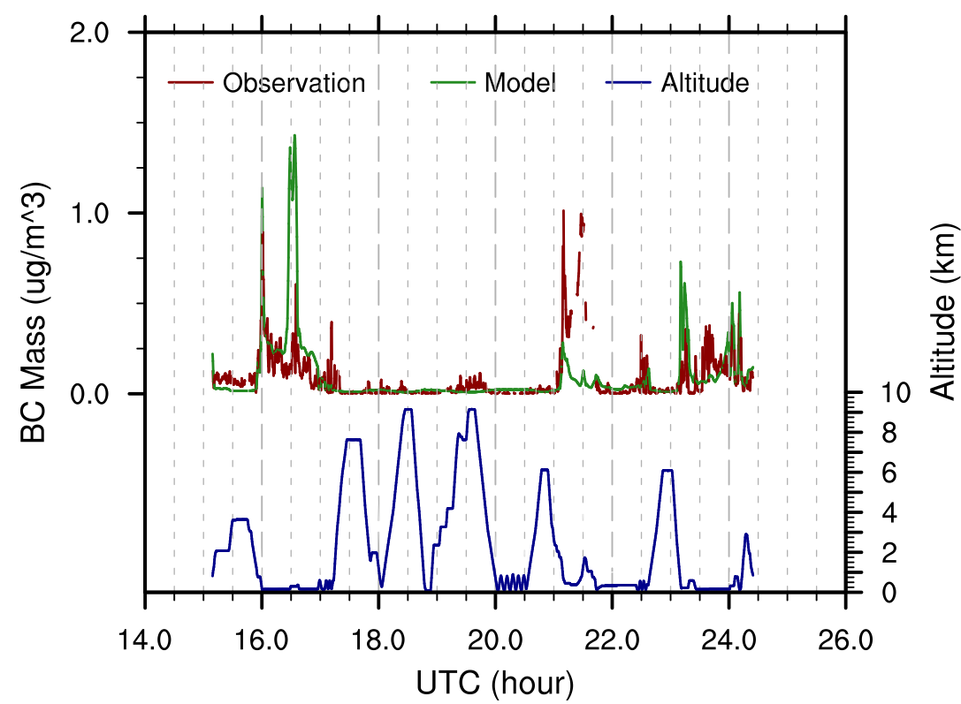
Typical air speed:
8-12 km/min
2 minute average observation (10 sec from instrument)
1 hour model interpolated to 10 sec measurement locations, then averaged every 2 minutes
Notes:
In order to compare model results to measurements, I’ve interpolated the model to the observation locations at the 10 sec sample interval.
Then I took a 2 minute running average of observed and modeled BC.
WRF-Chem captures the general trend of the observations.
However, the model over-predicts a peak near Los Angeles, and virtually misses the two peaks near the fires. The absolute accuracy of the measurement is estimated to be ~10%
Low bias near biomass burning sources, and high bias near anthropogenic sources.

Slide 18
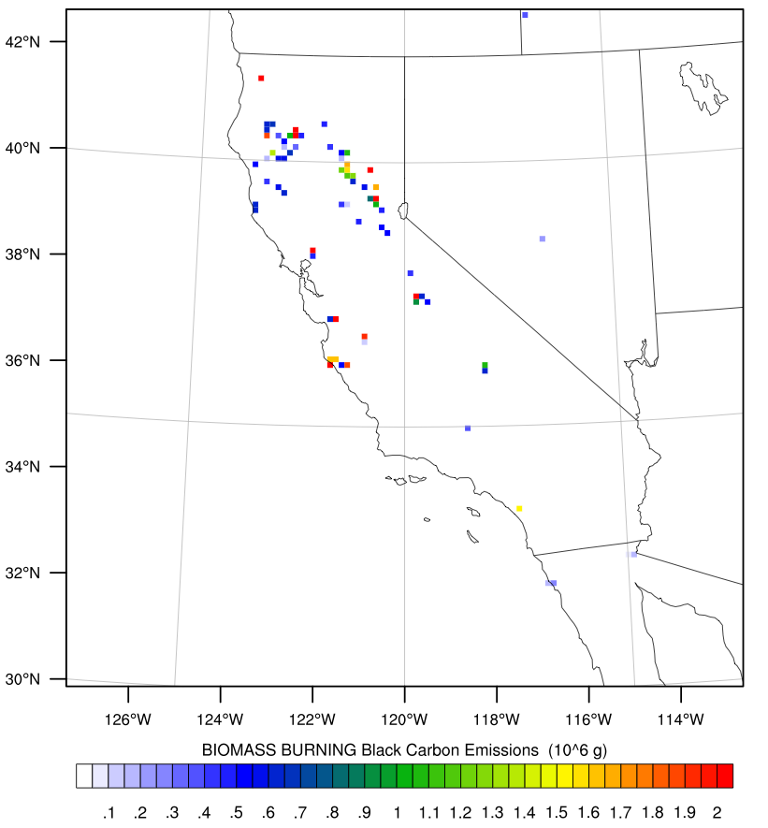
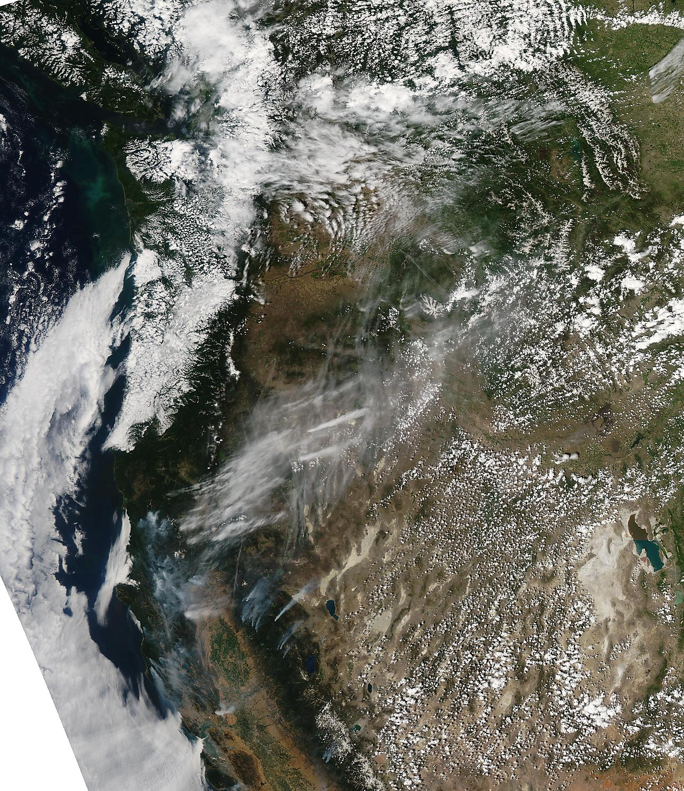


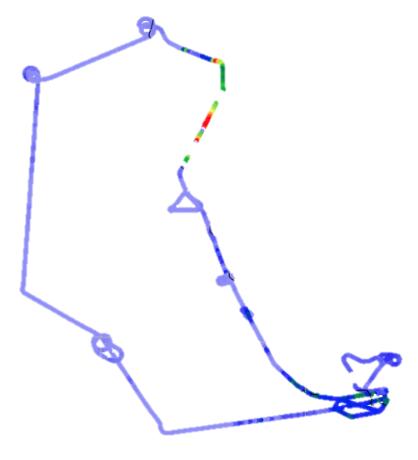


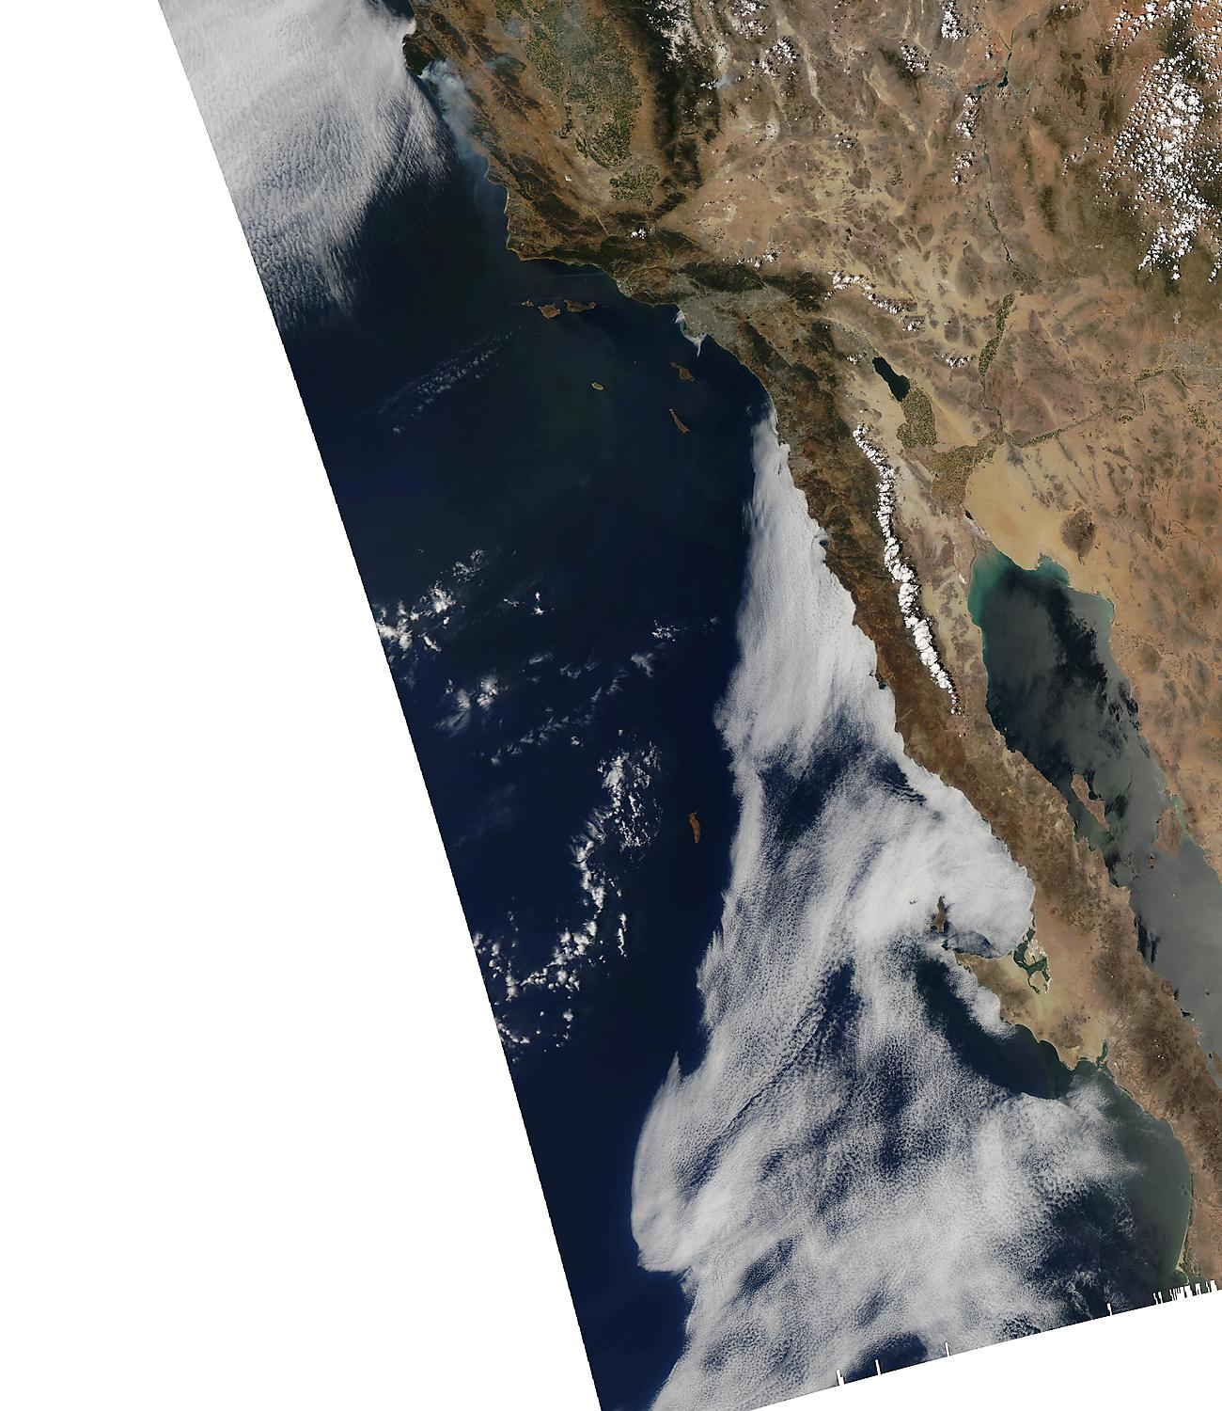
UTC 21:10
Jun 22, 2008
MODIS AQUA True Color
UTC 20:35 (12:35 PST)
12km Total daily BB Emissions
1min flight concentration
UTC 21:30
Large source, might need stronger advection
Small source might need to be bigger
Visible smoke, small/negligible source
PDT = UTC - 8
PST = UTC - 7
Notes:
Let’s look back at the map to see what might be happening. The background is a true color image from the MODIS AQUA satellite taken 35 minutes before our first error, and nearly an hour before the second one.
It shows us where large smoke plumes are originating. The total emissions for this day are overlayed.
Three possible sources of error arise by looking at this image:
1) In PURPLE, there is a significant amount of emissions that might need stronger advection to make it to the measurement location
2) In RED, there are two emission columns with small values that may need to be much larger to make up the difference in measurement error.
3) In ORANGE, there is a smoke plume without a square for emissions. It turns out there are emissions there, but they are less than the 50kg/day minimum bin which shows up on this plot.
[Fortunate for this study, many of the fires just got going on this day, otherwise the whole image would be filled with smoke. Individual fires would be unrecognizable]

Slide 19
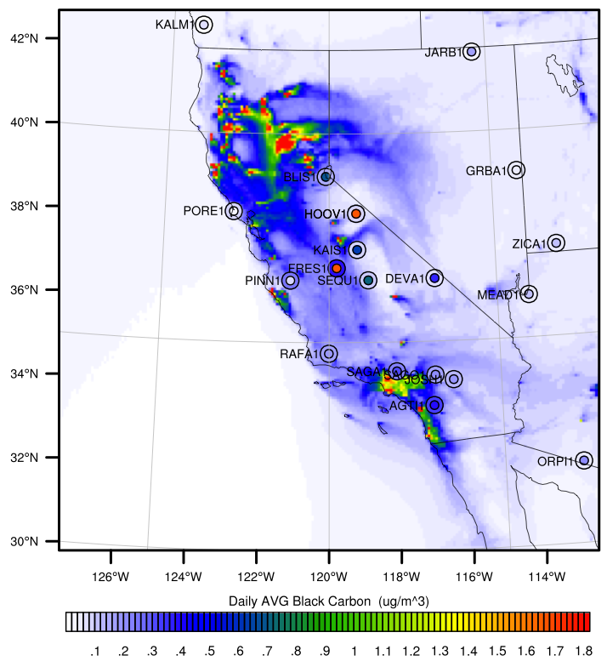
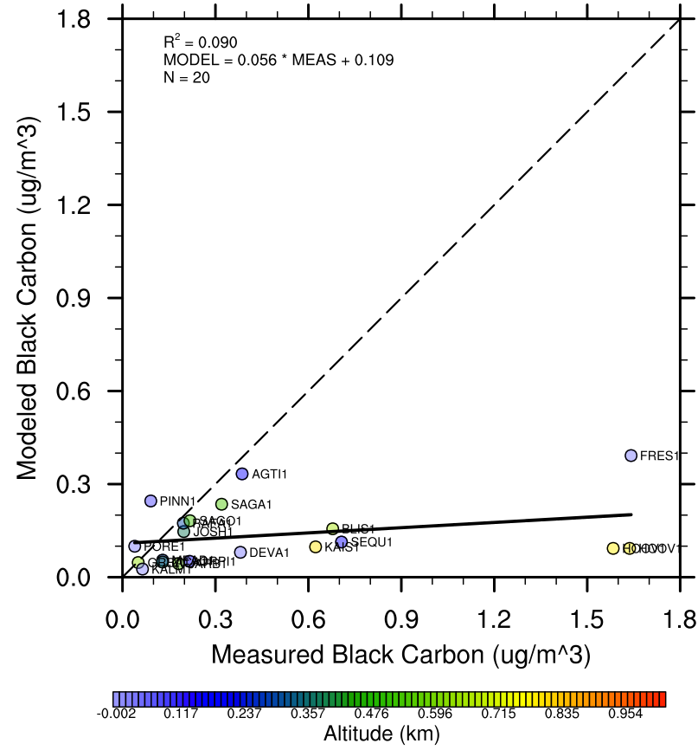
June 23 Average Surface BC (IMPROVE network)
Notes:
We should also consider a second observation set to confirm the speculated model bias in burning regions.
Indeed, surface measurements of average daily BC concentration on the following day show low model bias near burning sources, and relatively better agreement away from burning sources.

Slide 20
Adjoint Modeling
OUTPUTS: Sensitivity of a single scalar output to model inputs
INPUTS: Adjoint forcing
Adjoint variables are gradients of original model state variables, linearized at a chosen model configuration
Integrates backwards from final to initial time
Requires TRAJECTORY of nonlinear model state variables at every time step – memory intensive
Notes:
So in order to solve this conundrum, we look to adjoint modeling.

Slide 21
Adjoint Forcing
Choose the cost function
Take derivative w.r.t. state variables
Notes:
In this case, I’ve chosen the cost function as the sum of all Black Carbon in a volume.
The forcing for each grid point is the derivative of the cost function with respect to all state variables at the final time.
In this case, the cost function is only dependent on the BC concentration.
The derivative is unity within the chosen volume and zero outside of it.

Slide 22
New Adjoint Capabilities
Anthropogenic and Biomass Burning Emissions for BC and sulfate precursors
BC aging
Sulfate aerosol chemistry (TESTING)
PBL transport of chem species (DEVELOPING)
Deep cumulus convective transport of chem species (DEVELOPING)
Dust aerosols (FUTURE WORK)
Notes:
So far I have added adjoint modules for Emissions, BC aging from hydrophobic to hydrophilic.
I am still testing the sulfate aerosol adjoint.
The next pieces will be PBL and convective transport of chem species.

Slide 23
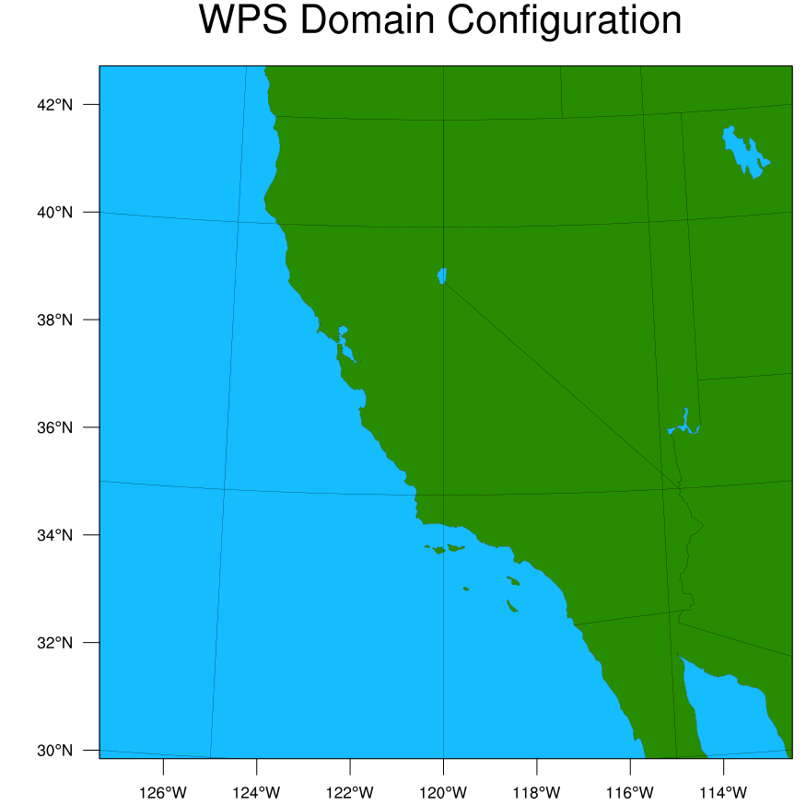
Finite Difference Test
Locations:
Final
Initial
i j k
i j k
28 64 | 1 24 | 64 1
28 64 | 1 28 | 63 1
28 64 | 1 26 | 63 1
28 64 | 1 26 | 65 1
28 64 | 1 26 | 64 2
35 53 | 1 31 | 53 1
35 53 | 1 35 | 52 1
35 53 | 1 33 | 52 1
35 53 | 1 33 | 54 1
35 53 | 1 33 | 53 2
*Approximate Depiction
Notes:
It is possible to compare the adjoint derivatives to finite difference derivatives to the adjoint derivatives for a limited number of points.
Here I have done so for two different final locations, and 5 initial locations each

Slide 24
Model Verification: Results
Notes:
At each of the initial locations, I’ve perturbed 7 different variables.
The plot on the left shows that the derivative of final hydrophobic BC w.r.t. the inputs matches well between adjoint and finite difference, with an exception for 2 temperature derivatives. These are not important for the results I’m about to show you, but I may need to reconsider them in the future.
The plot on the right shows that the same is true for hydrophilic black carbon, and more so confirms that black carbon aging is handled properly.

Slide 25
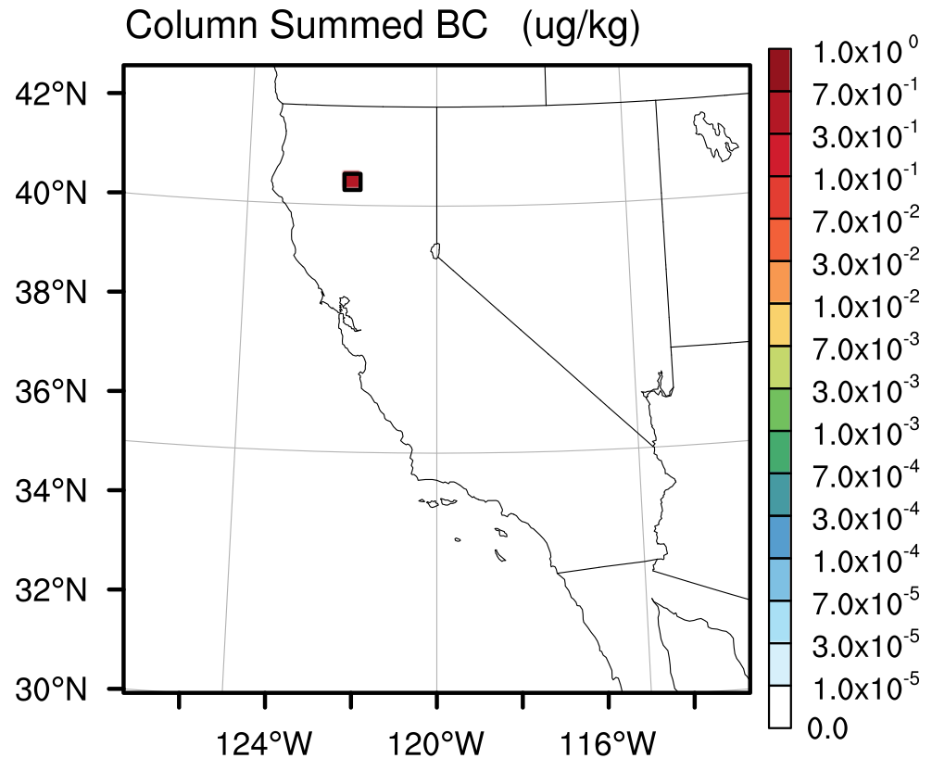
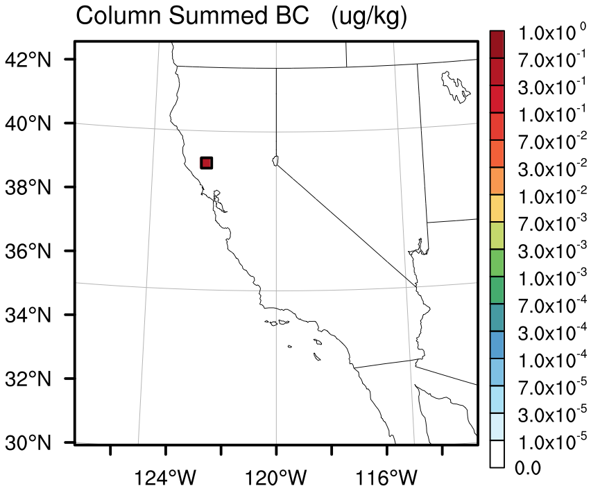
ARCTAS-CARB Sensitivity Study
dx = 18km
dt = 90 seconds
J1
21Z
J2
21Z
Notes:
So now let us revisit the ARCTAS-CARB campaign.
I have chosen the two locations where the model is underpredicting fire emissions.
For both, the cost function is the total grid cell concentration for the 4 columns closest to the measurements.
Also notice that the cost function is at 21Z, because that is the hour closest to the measurements.
(I am only able to force every 3 hours at the moment.)
========================================================================================================================
…If anybody asks…the weighting is such that each grid cell is waited equally, and not so that each unit mass is waited equally.
This is because the grid cells are all different masses due to level thickness and air density differences.

Slide 26
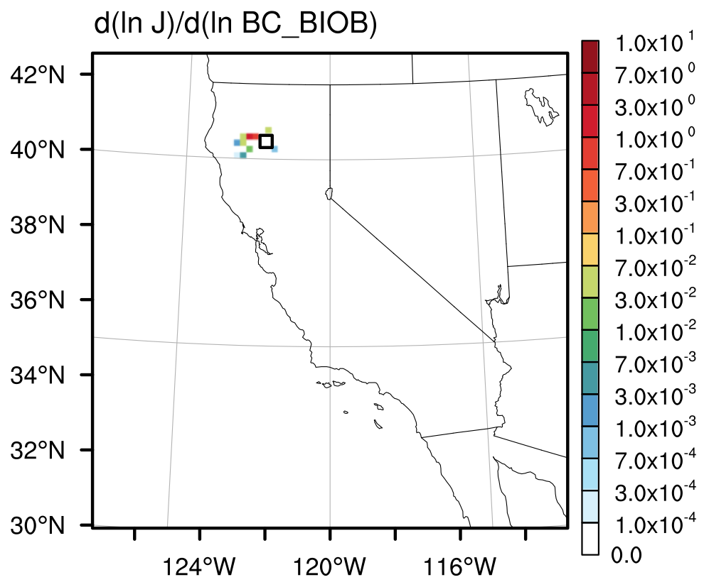
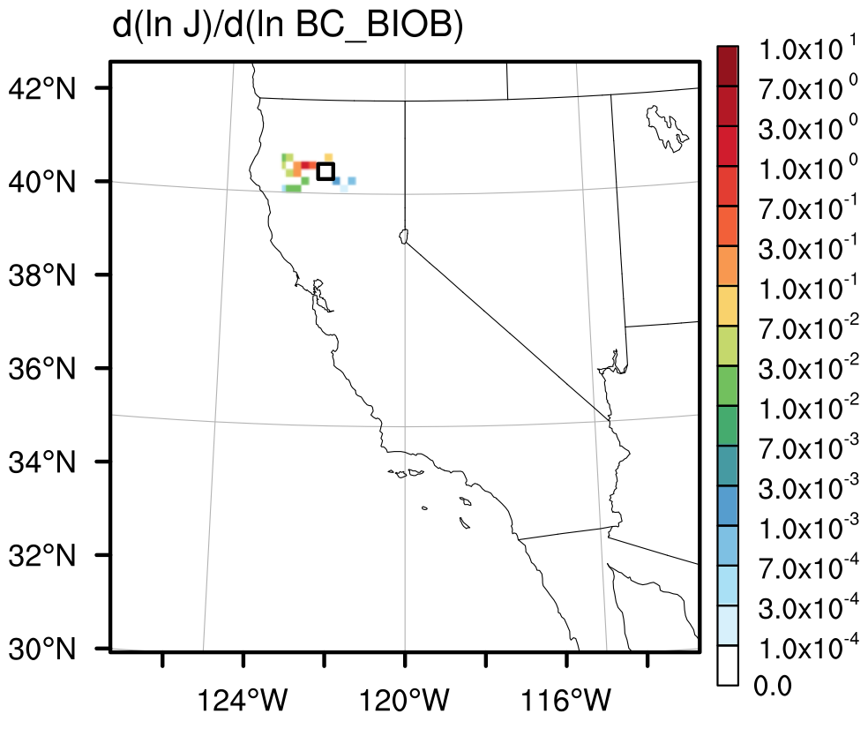
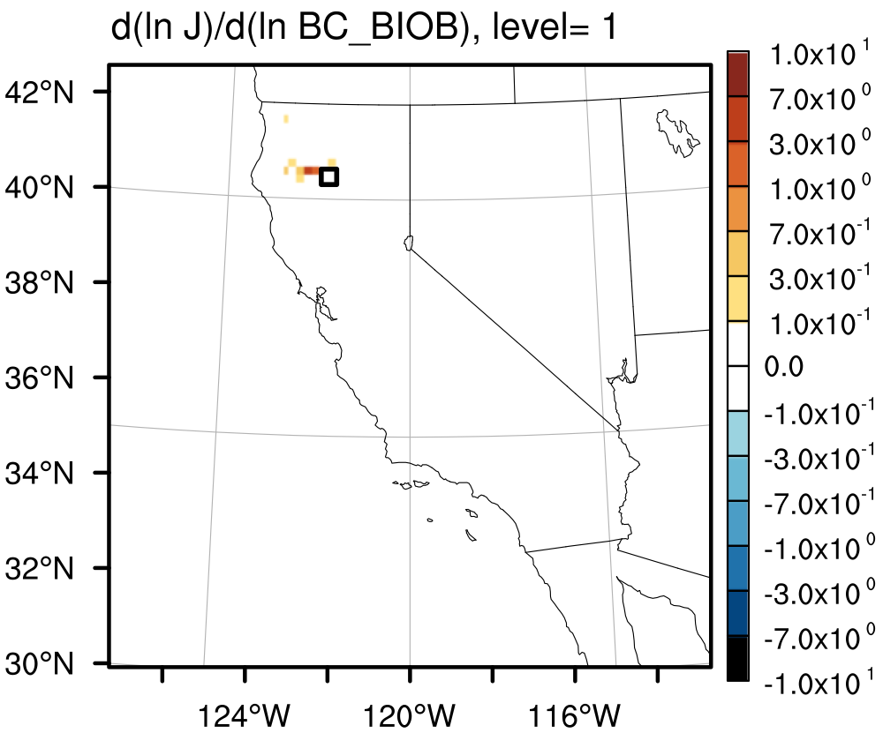
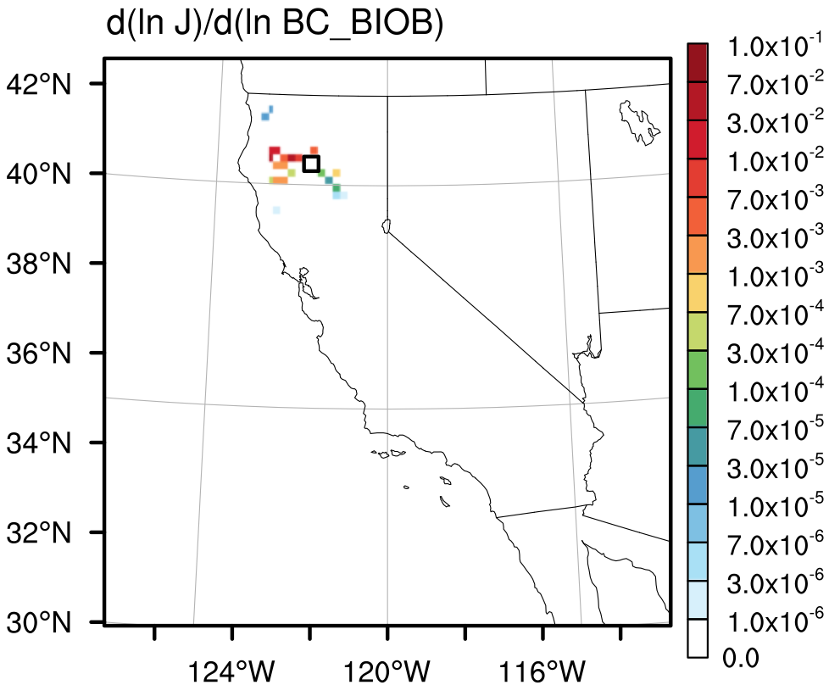
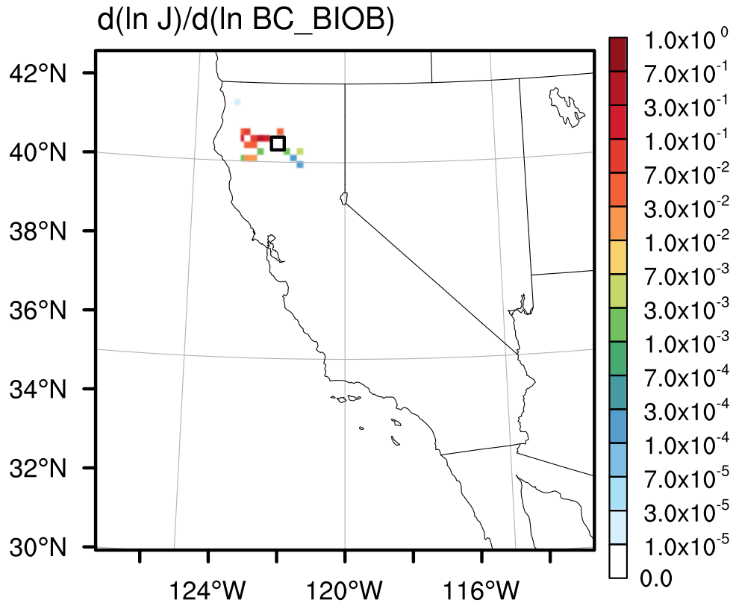
Sensitivity of Column BC to Emissions(x,t)
J1
21Z
20Z
19Z
SUM(00Z,01Z,…,20Z)
17Z
18Z
Notes:
Here are the results for the first cost function.
The sensitivities are w.r.t. the biomass burning emissions only for the following hour. So the 20Z first plot is the sensitivity of J1 w.r.t. emissions from 20Z to 21Z.
Notice that the magnitude is decreasing as we go back in time. The maximum value has decreased 2 orders of magnitude within 4 hours.
So nearly 99% of the sensitivity to burning emissions is attributable to the 4 hours preceding the measurement.
We can also look at the sum of all emissions sensitivities to get an idea of the spatial spread of sensitivity. Even emissions up near Crescent City were important for this cost function.

Slide 27
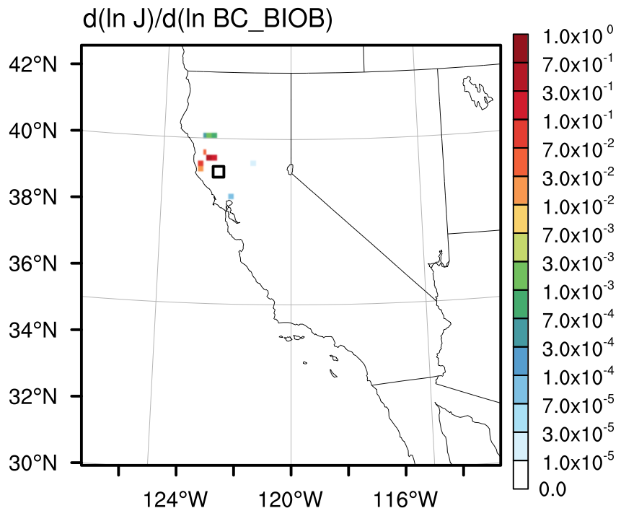
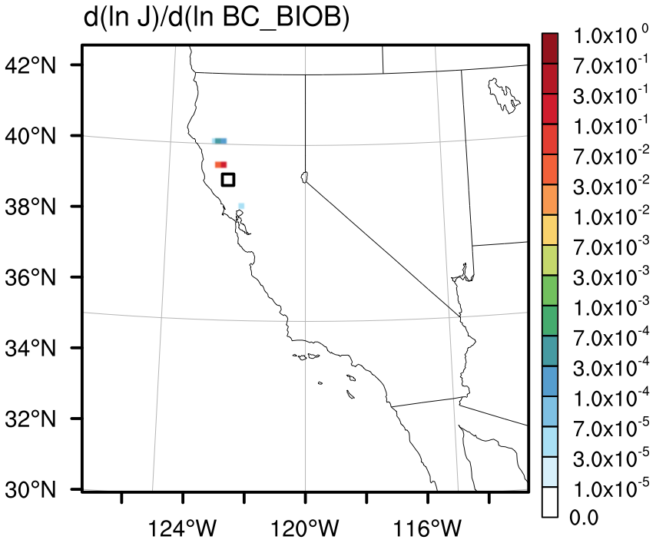
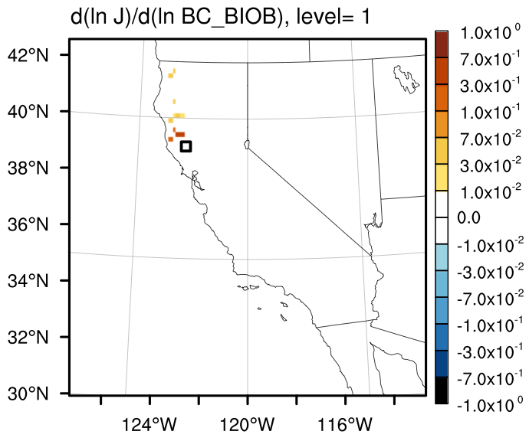

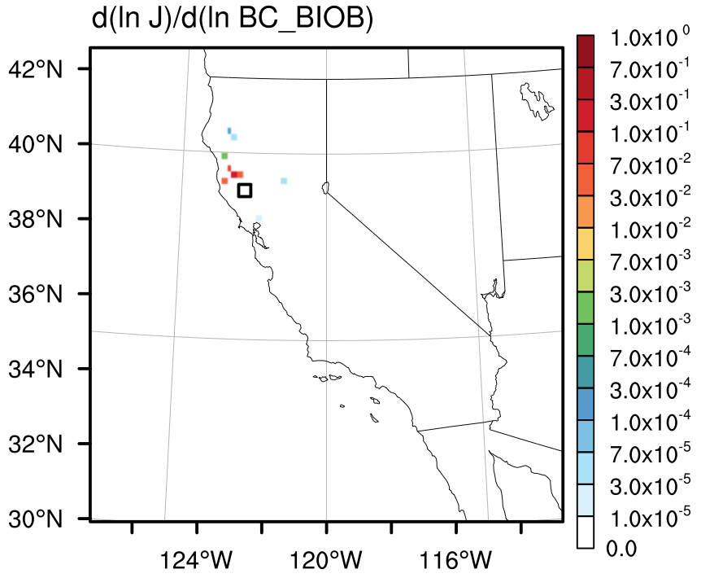
Sensitivity of Column BC to Emissions(x,t)
J2
21Z
20Z
19Z
SUM(00Z,01Z,…,20Z)
17Z
18Z
Notes:
Now if we look at the second cost function, a similar picture arises.
However, the magnitude of sensitivities starts out much smaller.
The summed plot shows that this measurement is influenced by burning emissions reaching up to Crescent city as well.

Slide 28
Large source, might need stronger advection
Small source might need to be bigger
Visible smoke, small/negligible source
Notes:
Recall the burning emissions overlayed by the flight track. I’ve simply removed the true color MODIS image.
Now allow me to change the colors and overlay the burning emission sensitivities.

Slide 29
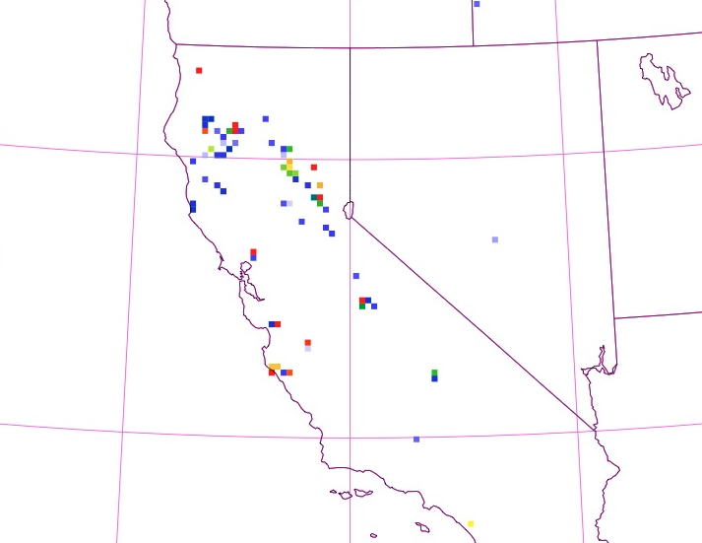
Large source, might need stronger advection
Small source might need to be bigger
Visible smoke, small/negligible source
Notes:
Recall the burning emissions overlayed by the flight track. I’ve simply removed the true color MODIS image.
Now allow me to change the colors and overlay the burning emission sensitivities.

Slide 30


Large source, might need stronger advection
Small source might need to be bigger
Visible smoke, small/negligible source
Notes:
Keep in mind that the two cost functions had different maximum sensitivity values.
What we see is that the measurements are indeed sensitive to the emissions that were marked previously.
There are additional non-negligible sensitivities to emissions that were too small to be outside the minimum bin value of 50kg per day.
There are several of this type of location, including right next to where we saw smoke, but no emissions.
To be thorough, I would need to consider the anthropogenic emission sensitivities too.

Slide 31
Next Steps
Increase Adjoint resolution to 12km (3.375x memory and time requirements)
Add PBL and Cumulus Convection adjoints to trace back vertical transport
Include multiple obs. and multiple obs. types in a single adjoint simulation
Long Term: 4DVar Data Assimilation

Slide 32
References
2007 Report to Congress on the Benefits and Costs of Federal Regulations and Unfunded Mandates on State, Local, and Tribal Entities. Office of Management and Budget, Office of Information and Regulatory Affairs. June 2008.
Bond, T. C. and Doherty, S. J. and Fahey, D. W. and Forster, P. M. and Berntsen, T. and DeAngelo, B. J. and Flanner, M. G. and Ghan, S. and Kärcher, B. and Koch, D. and Kinne, S. and Kondo, Y. and Quinn, P. K. and Sarofim, M. C. and Schultz, M. G. and Schulz, M. and Venkataraman, C. and Zhang, H. and Zhang, S. and Bellouin, N. and Guttikunda, S. K. and Hopke, P. K. and Jacobson, M. Z. and Kaiser, J. W. and Klimont, Z. and Lohmann, U. and Schwarz, J. P. and Shindell, D. and Storelvmo, T. and Warren, S. G. and Zender, C. S. Bounding the role of black carbon in the climate system: A scientific assessment. Journal of Geophysical Research, Volume 118, Issue 11, 5380-5552, doi:10.1002/jgrd.50171, Jun 2013.
Koch, D. and Schulz, M. and Kinne, S. and McNaughton, C. and Spackman, J. R. and Balkanski, Y. and Bauer, S. and Berntsen, T. and Bond, T. C. and Boucher, O. and Chin, M. and Clarke, A. and De Luca, N. and Dentener, F. and Diehl, T. and Dubovik, O. and Easter, R. and Fahey, D. W. and Feichter, J. and Fillmore, D. and Freitag, S. and Ghan, S. and Ginoux, P. and Gong, S. and Horowitz, L. and Iversen, T. and Kirkevåg, A. and Klimont, Z. and Kondo, Y. and Krol, M. and Liu, X. and Miller, R. and Montanaro, V. and Moteki, N. and Myhre, G. and Penner, J. E. and Perlwitz, J. and Pitari, G. and Reddy, S. and Sahu, L. and Sakamoto, H. and Schuster, G. and Schwarz, J. P. and Seland, Ø. and Stier, P. and Takegawa, N. and Takemura, T. and Textor, C. and van Aardenne, J. A. and Zhao, Y. Evaluation of black carbon estimations in global aerosol models, Atmos. Chem. Phys., 9, 9001-9026, 2009.
W.C. Skamarock, Joseph B. Klemp, Jimy Dudhia, David O. Gill, Dale M. Barker, Michael E. Duda, Xiang-Yu Huang, Wei Wang, and Jordan G. Powers. A Description of the Advanced Research WRF Version 3. NCAR Technical Note. Boulder, Colorado, USA: National Center for Atmospheric Research, Mesocale and Microscale Meteorology Division, June 2008.
G. A. Grell et al., “Fully coupled ‘online’ chemistry within the WRF model,” Atmospheric Environment, vol. 39, no. 37, pp. 6957–6975, 2005.
Jacob, D. J., Crawford, J. H., Maring, H., Clarke, A. D., Dibb, J. E., Emmons, L. K., Ferrare, R. A., Hostetler, C. A., Russell, P. B., Singh, H. B., Thompson, A. M., Shaw, G. E., McCauley, E., Pederson, J. R., and Fisher, J. A.: The Arctic Research of the Composition of the Troposphere from Aircraft and Satellites (ARCTAS) mission: design, execution, and first results, Atmos. Chem. Phys., 10, 5191-5212, doi:10.5194/acp-10-5191-2010, 2010.
Wiedinmyer, C., Akagi, S. K., Yokelson, R. J., Emmons, L. K., Al-Saadi, J. A., Orlando, J. J., and Soja, A. J.: The Fire INventory from NCAR (FINN): a high resolution global model to estimate the emissions from open burning, Geosci. Model Dev., 4, 625-641, doi:10.5194/gmd-4-625-2011, 2011.

Slide 33
Bottom-up Emission Inventories
Anthropogenic
Biomass Burning (0.29-5.0x uncertainty bands)
A = activity
EF = emission factor
eff = abatement efficiency
BA = burned area
FL = fuel load
CC = combustion completeness
EF = emission factor
Bond et al. (2013)
Notes:
Depending on the location of the emissions, each of these coefficients is known to a differing level.
Activity (particular fuel consumed or commodity produced)
EF (grams of compound per activity)
eff (percent abated)
BA (km^2)
FL (kg dry matter per km^2) – depends on vegetation type
CC (fraction)
EF (g compound per kg burned)

Slide 34
Sensitivity of Column BC to Emissions(x,t)
J1
21Z
20Z
19Z
SUM(00Z,01Z,…,20Z)
17Z
18Z
Notes:
Here are the results for the first cost function.
The sensitivities are w.r.t. the biomass burning emissions only for the following hour. So the 20Z first plot is the sensitivity of J1 w.r.t. emissions from 20Z to 21Z.
Notice that the magnitude is decreasing as we go back in time. The maximum value has decreased 2 orders of magnitude within 4 hours.
So nearly 99% of the sensitivity to burning emissions is attributable to the 4 hours preceding the measurement.
We can also look at the sum of all emissions sensitivities to get an idea of the spatial spread of sensitivity. Even emissions up near Crescent City were important for this cost function.

Slide 35
Sensitivity of Column BC to Emissions(x,t)
J2
21Z
20Z
19Z
SUM(00Z,01Z,…,20Z)
17Z
18Z
Notes:
Now if we look at the second cost function, a similar picture arises.
However, the magnitude of sensitivities starts out much smaller.
The summed plot shows that this measurement is influenced by burning emissions reaching up to Crescent city as well.

Slide 36
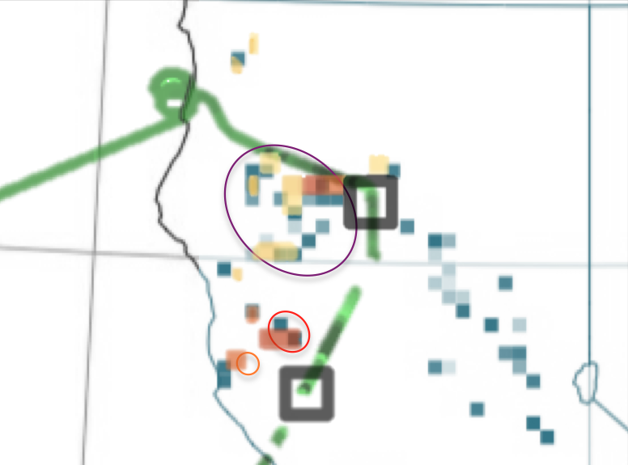
Large source, might need stronger advection
Small source might need to be bigger
Visible smoke, small/negligible source
Notes:
Keep in mind that the two cost functions had different maximum sensitivity values.
What we see is that the measurements are indeed sensitive to the emissions that were marked previously.
There are additional non-negligible sensitivities to emissions that were too small to be outside the minimum bin value of 50kg per day.
There are several of this type of location, including right next to where we saw smoke, but no emissions.
To be thorough, I would need to consider the anthropogenic emission sensitivities too.

